Slide 1
Course Title: Engineering Chemistry-1
Course Code: CHE109
(Chapter 8)
Dr. Joyanta Kumar Saha
Associate Professor
Department of Chemistry
Jagannath University

Slide 2
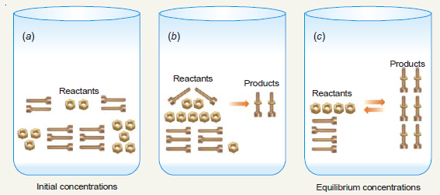
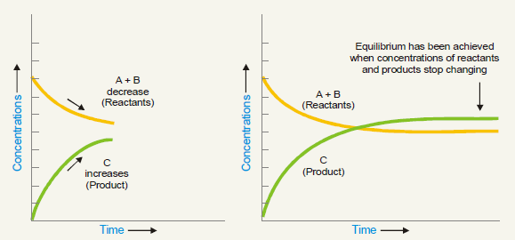
Chemical Equilibrium
Reversible Reactions: A reaction which can go in the forward and backward direction simultaneously is called reversible reaction. A + B C + D

Slide 3
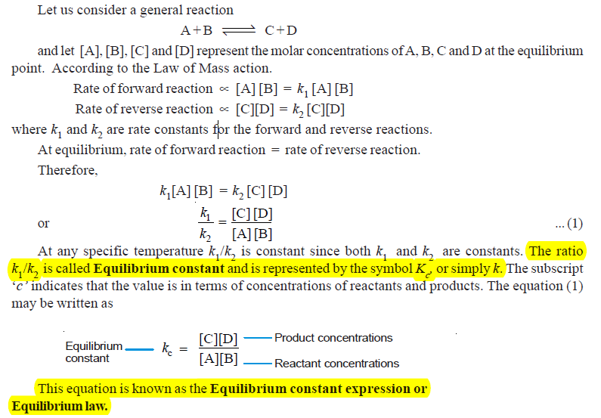
EQUILIBRIUM CONSTANT : EQUILIBRIUM LAW

Slide 5
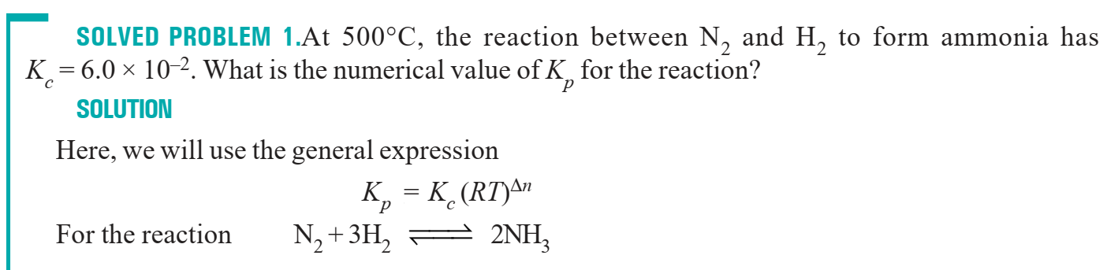
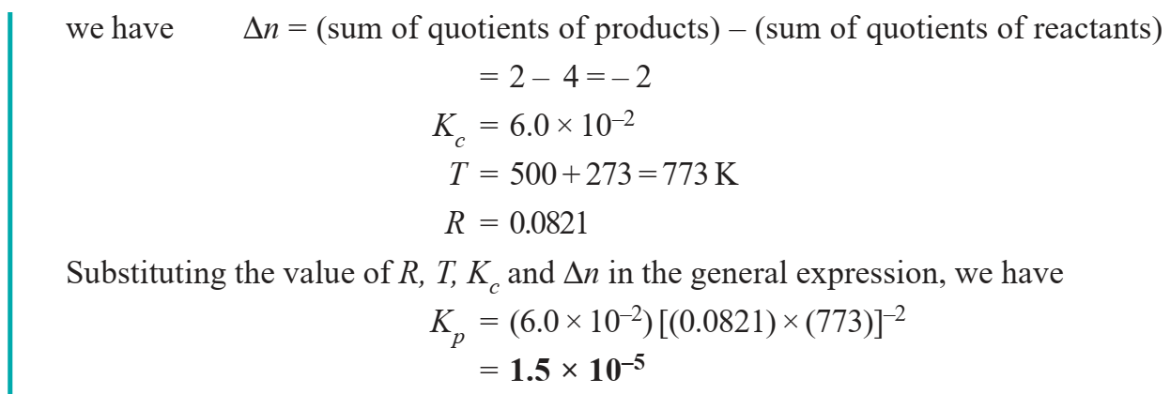

Slide 6
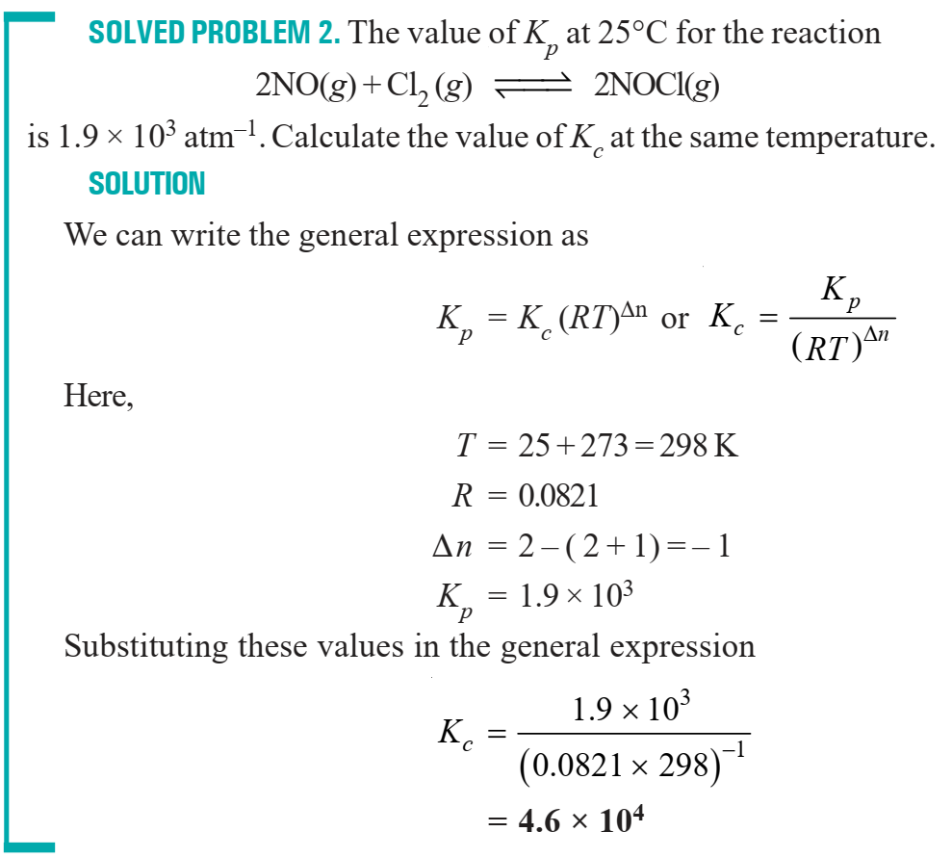

Slide 7
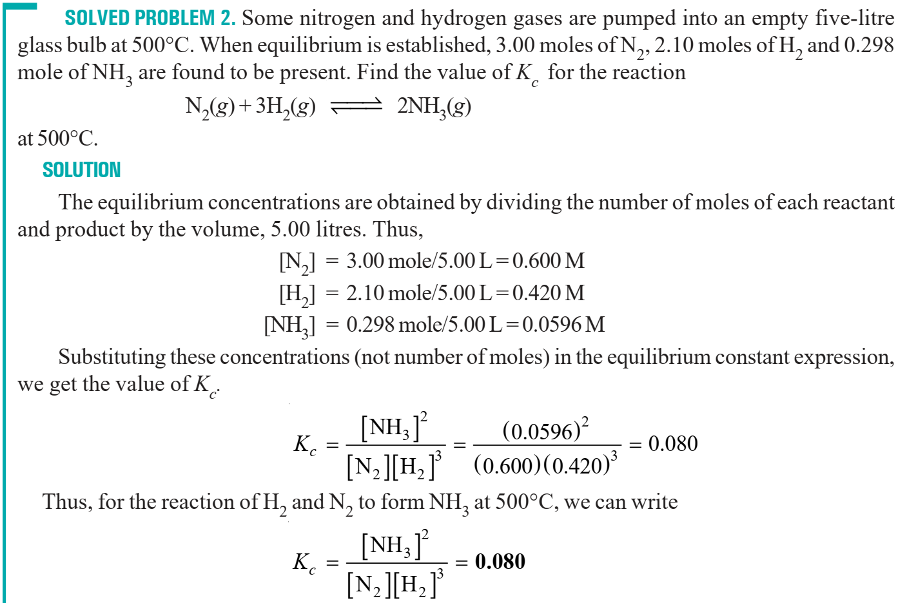

Slide 8
Thermodynamics
The study of the flow of heat or any other form of energy into or out of a system as it undergoes a physical or chemical transformation, is called Thermodynamics. In studying and evaluating the flow of energy into or out of a system, it will be useful to consider changes in certain properties of the system. These properties include temperature, pressure, volume and concentration of the system. Measuring the changes in these properties from the initial state to the final state, can provide information concerning changes in energy and related quantities such as heat and work.
The study of thermodynamics is based on three broad generalisations derived from well established experimental results. These generalisations are known as the First, Second and Third law of thermodynamics.

Slide 9
Scope of Thermodynamics (1) Most of the important laws of Physical Chemistry, including the van’t Hoff law of lowering of vapour pressure, Phase Rule and the Distribution Law, can be derived from the laws of thermodynamics. (2) It tells whether a particular physical or chemical change can occur under a given set of conditions of temperature, pressure and concentration. (3) It also helps in predicting how far a physical or chemical change can proceed, until the equilibrium conditions are established.

Slide 10
Limitations of Thermodynamics (1) Thermodynamics is applicable to macroscopic systems consisting of matter in bulk and not to microscopic systems of individual atoms or molecules. It ignores the internal structure of atoms and molecules. (2) Thermodynamics does not bother about the time factor. That is, it does not tell anything regarding the rate of a physical change or a chemical reaction. It is concerned only with the initial and the final states of the system.

Slide 11
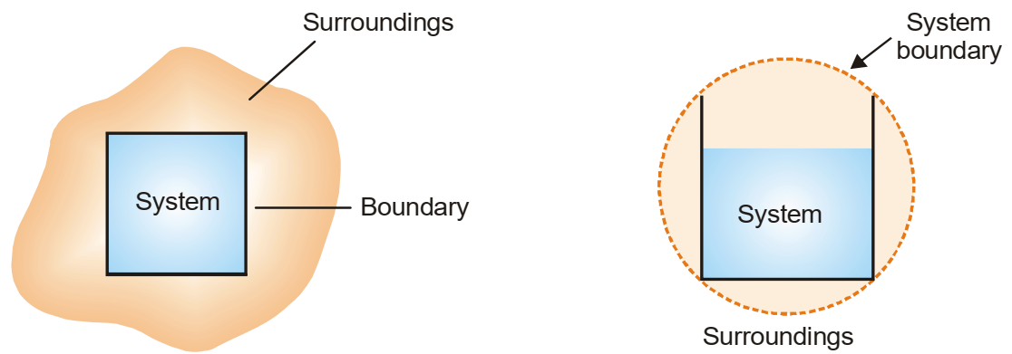
SYSTEM, BOUNDARY, SURROUNDINGS A system is that part of the universe which is under thermodynamic study and the rest of the universe is surroundings. The real or imaginary surface separating the system from the surroundings is called the boundary.

Slide 12
HOMOGENEOUS AND HETEROGENEOUS SYSTEMS
When a system is uniform throughout, it is called a Homogeneous System. Examples are : a pure single solid, liquid or gas, mixtures of gases, and true solution of a solid in a liquid. A homogeneous system is made of one phase only. A phase is defined as a homogeneous, physically distinct and mechanically separable portion of a system. A heterogeneous system is one which consists of two or more phases. In other words it is not uniform throughout. Examples of heterogeneous systems are : ice in contact with water, ice in contact with vapour etc. Here ice, water and vapour constitute separate phases.

Slide 13
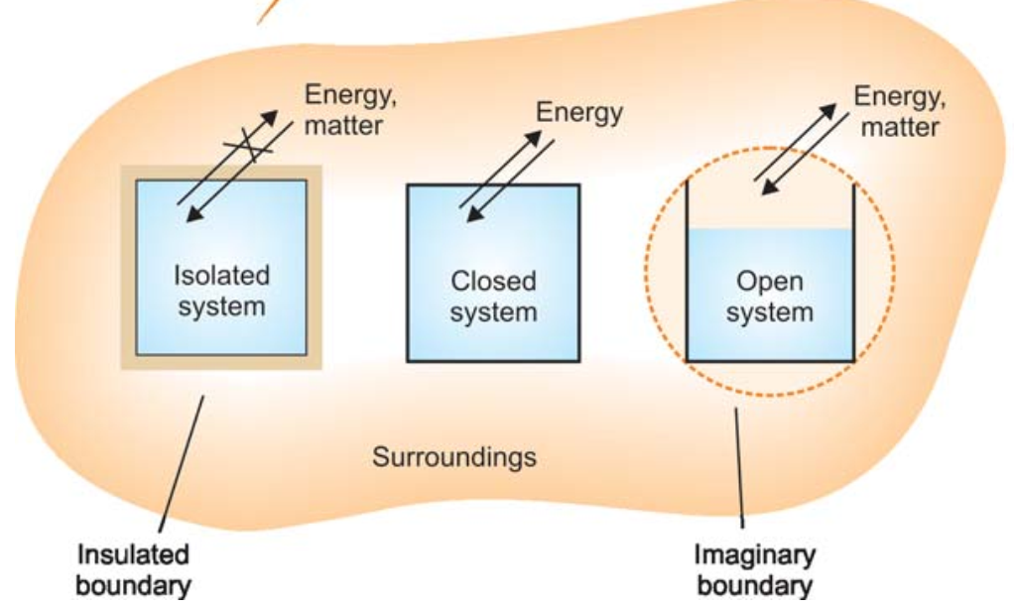
TYPES OF THERMODYNAMIC SYSTEMS
(1) Isolated System : an isolated system is one that can transfer neither matter nor energy to and from its surroundings. (2) Closed System : a closed system is one which cannot transfer matter but can transfer energy in the form of heat, work and radiation to and from its surroundings. (3) Open System : an open system is one which can transfer both energy and matter to and from its surroundings.

Slide 14
THERMODYNAMIC PROCESSES 1) Isothermal Processes : Those processes in which the temperature remains fixed, are termed isothermal processes.
(2) Adiabatic Processes : Those processes in which no heat can flow into or out of the system, are called adiabatic processes. (3) Isobaric Processes : Those processes which take place at constant pressure are called isobaric processes.
(4) Isochoric Processes : Those processes in which the volume remains constant are known as isochoric processes. (5) Cyclic Process : When a system in a given state goes through a number of different processes and finally returns to its initial state, the overall process is called a cycle or cyclic process.

Slide 15
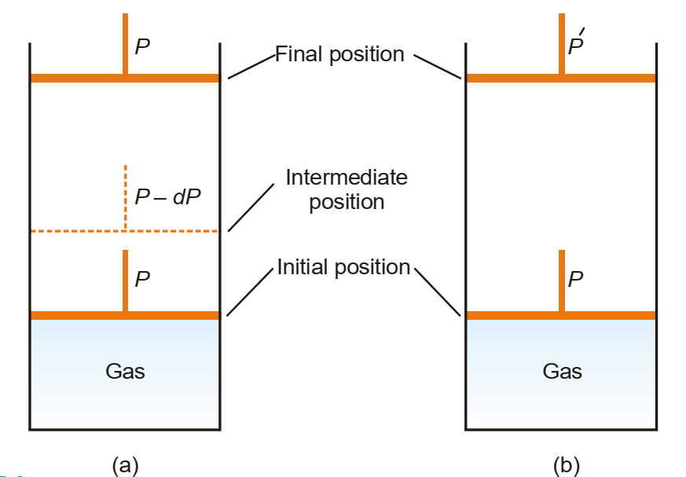
REVERSIBLE AND IRREVERSIBLE PROCESSES A thermodynamic reverse process is one that takes place infinitesimally slowly and its direction at any point can be reversed by an infinitesimal change in the state of the system.
When a process goes from the initial to the final state in a single step and cannot be carried in the reverse order, it is said to be an irreversible process.

